Slide 1

Deep Learning and Homomorphic Encryption
Homomorphic Inference

Slide 2
Training vs Inference
Convolutional Layer
Fully Connected Layer
Homomorphic Vector-Matrix Multiplication
Homomorphic Convolution
Implementation
Activation Layer
Contents

Slide 3
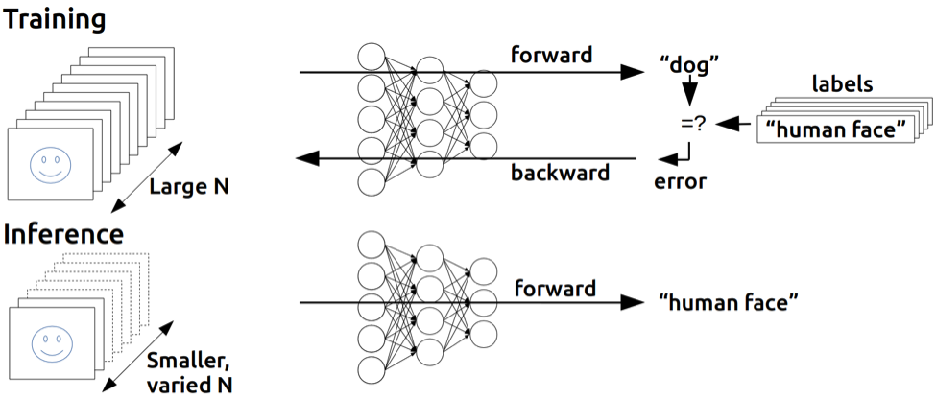
Training vs Inference

Slide 4
Convolution
0 | 1 | 2 | 3 | 4 | 5
6 | 7 | 8 | 9 | 0 | 1
2 | 3 | 4 | 5 | 6 | 7
8 | 9 | 0 | 1 | 2 | 3
4 | 5 | 6 | 7 | 8 | 9
0 | 1 | 2 | 3 | 4 | 5
A
1 | 0 | -1
1 | 0 | -1
1 | 0 | -1
*
=
Filter / Kernel
Stride is 1
A = 0*1+1*0+2*(-1)+6*1+7*0+8*(-1)+2*1+3*0+4*(-1) = -6
0 | 1 | 2 | 3 | 4 | 5
6 | 7 | 8 | 9 | 0 | 1
2 | 3 | 4 | 5 | 6 | 7
8 | 9 | 0 | 1 | 2 | 3
4 | 5 | 6 | 7 | 8 | 9
0 | 1 | 2 | 3 | 4 | 5
A | B
1 | 0 | -1
1 | 0 | -1
1 | 0 | -1
*
=
Filter / Kernel
B = 1*1+2*0+3*(-1)+7*1+8*0+9*(-1)+3*1+4*0+5*(-1) = -6

Slide 5
Convolution
0 | 1 | 2 | 3 | 4 | 5
6 | 7 | 8 | 9 | 0 | 1
2 | 3 | 4 | 5 | 6 | 7
8 | 9 | 0 | 1 | 2 | 3
4 | 5 | 6 | 7 | 8 | 9
0 | 1 | 2 | 3 | 4 | 5
1 | 0 | -1
1 | 0 | -1
1 | 0 | -1
A
*
=
Filter / Kernel
Stride is 2
A = 0*1+1*0+2*(-1)+6*1+7*0+8*(-1)+2*1+3*0+4*(-1) = -6
0 | 1 | 2 | 3 | 4 | 5
6 | 7 | 8 | 9 | 0 | 1
2 | 3 | 4 | 5 | 6 | 7
8 | 9 | 0 | 1 | 2 | 3
4 | 5 | 6 | 7 | 8 | 9
0 | 1 | 2 | 3 | 4 | 5
1 | 0 | -1
1 | 0 | -1
1 | 0 | -1
A | B
*
=
Filter / Kernel
B = 2*1+3*0+4*(-1)+8*1+9*0+0*(-1)+4*1+5*0+6*(-1) = 4

Slide 6
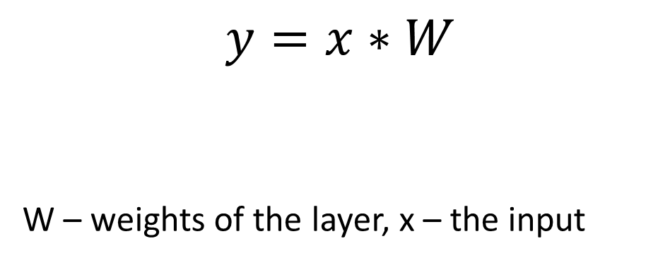
Fully Connected Layer
It is simply a matrix multiplication.
The input is flattened to 1D before feeding to the layer.
$$y=x∗W$$
W – weights of the layer, x – the input

Slide 7




Activation Layer
Usually after each layer, a non-linear function is applied.
None of these functions are supported in Homomorphic Encryption.
This is because in HE only addition and multiplication operations are supported.

Slide 8
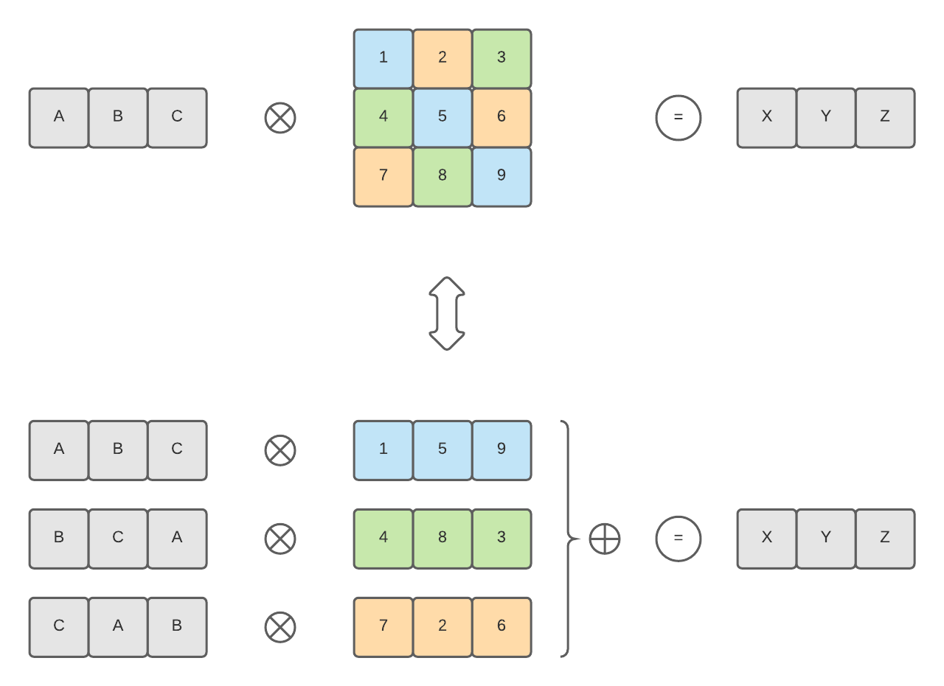
Homomorphic Vector-Matrix Multiplication

Slide 9
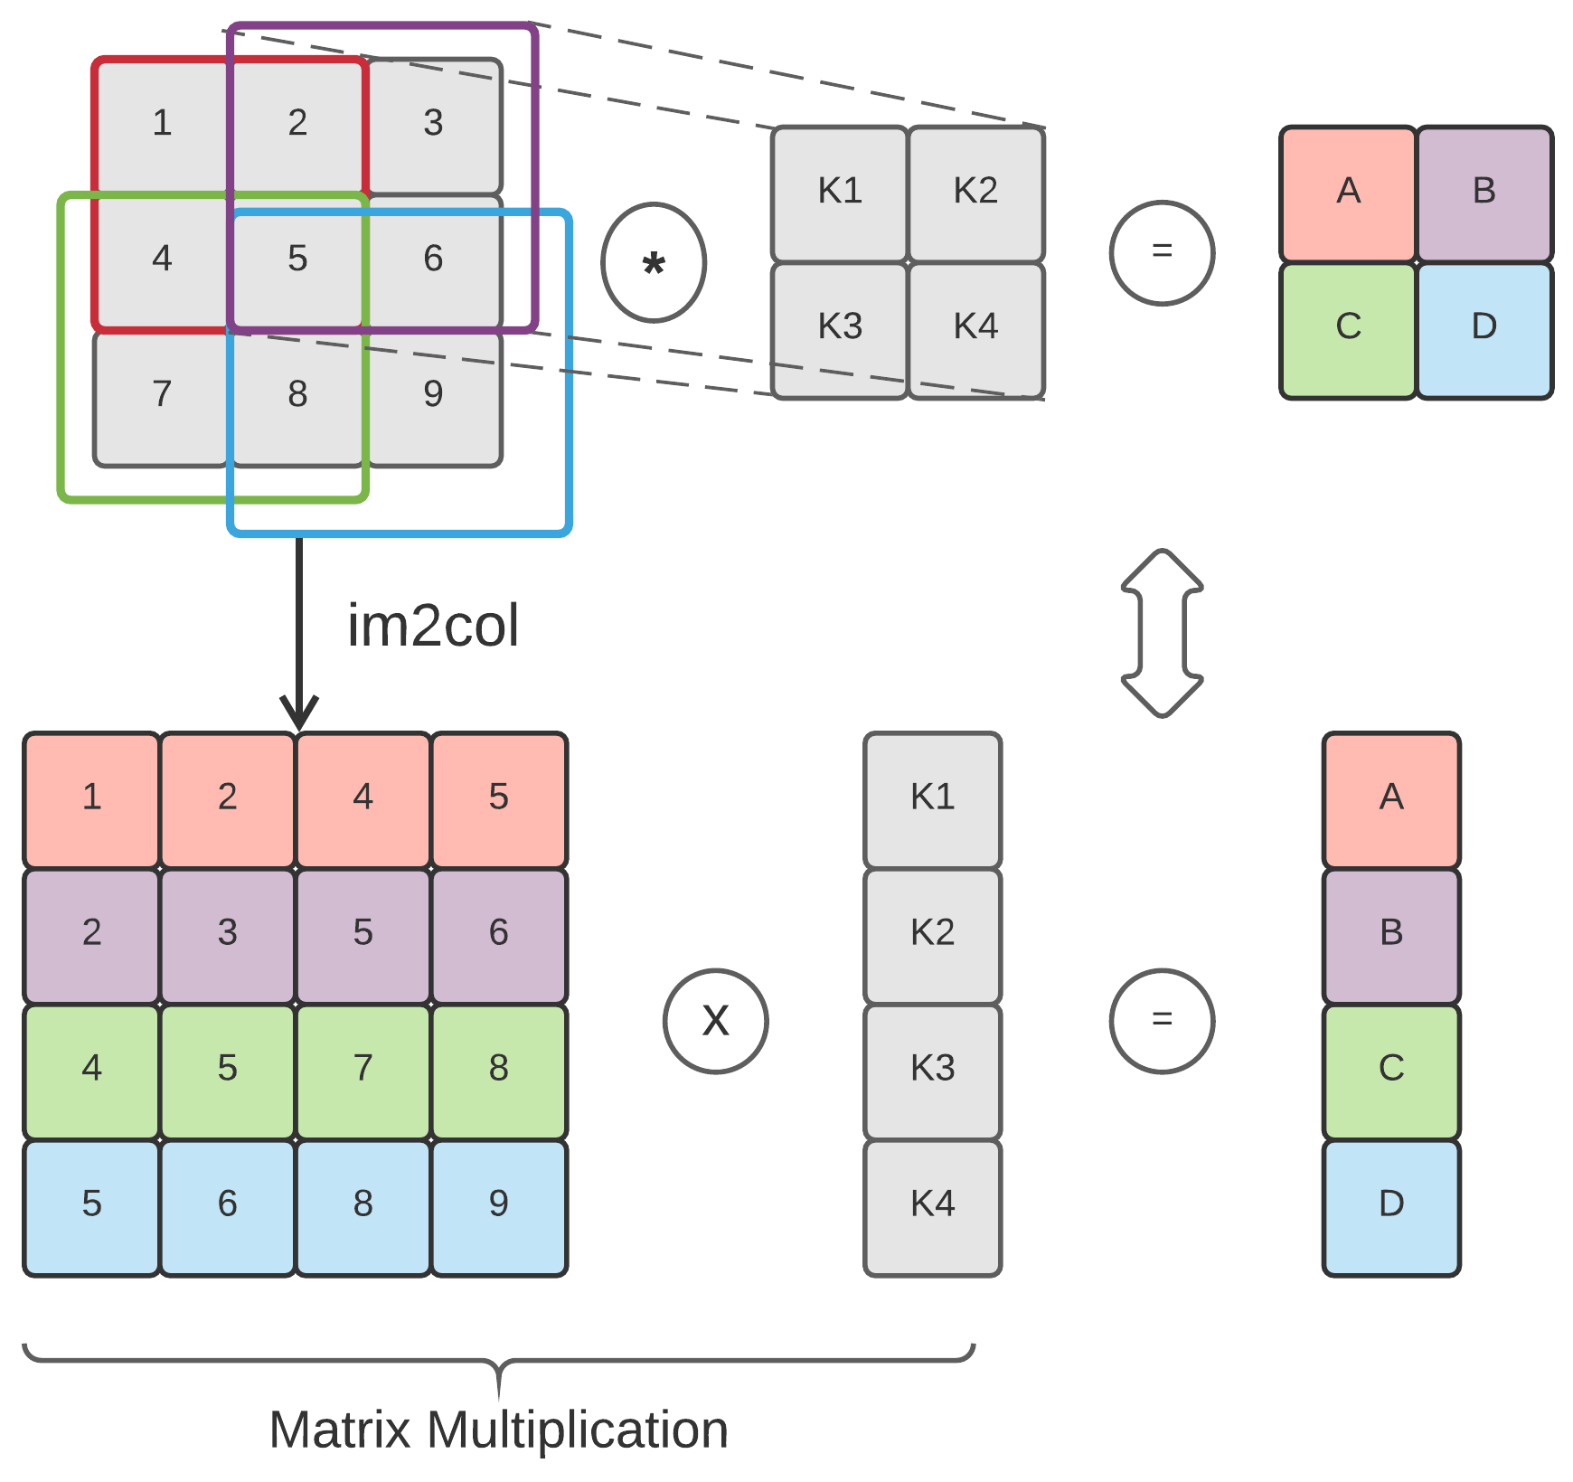
Homomorphic Convolution

Slide 10
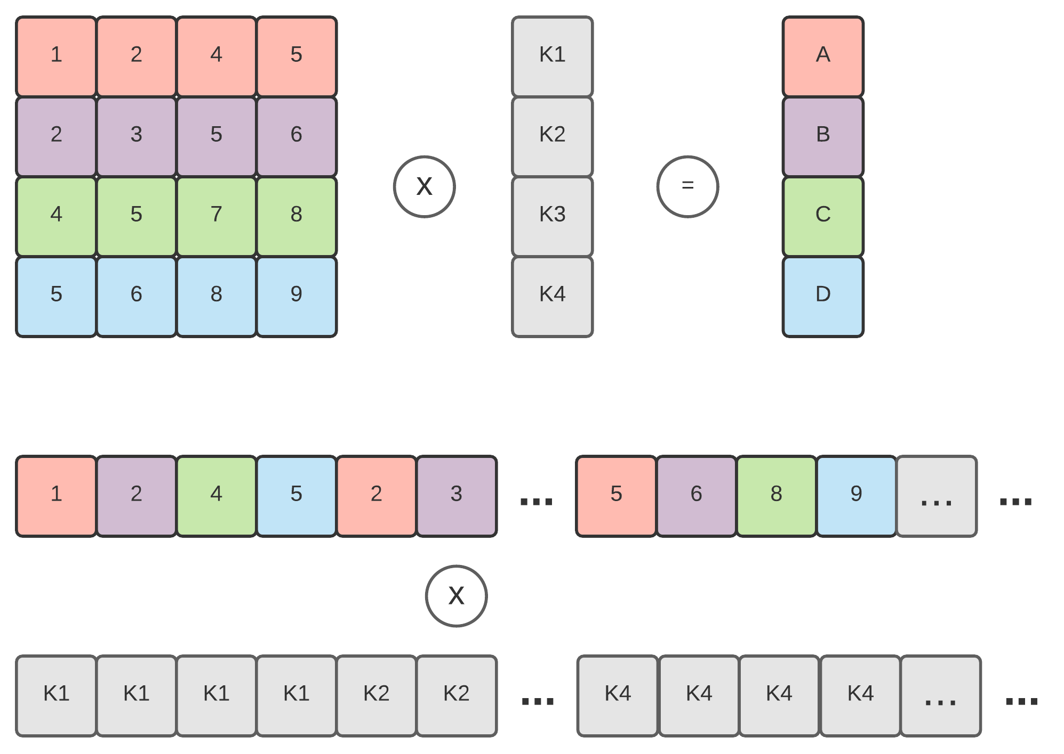
Homomorphic Convolution

Slide 11
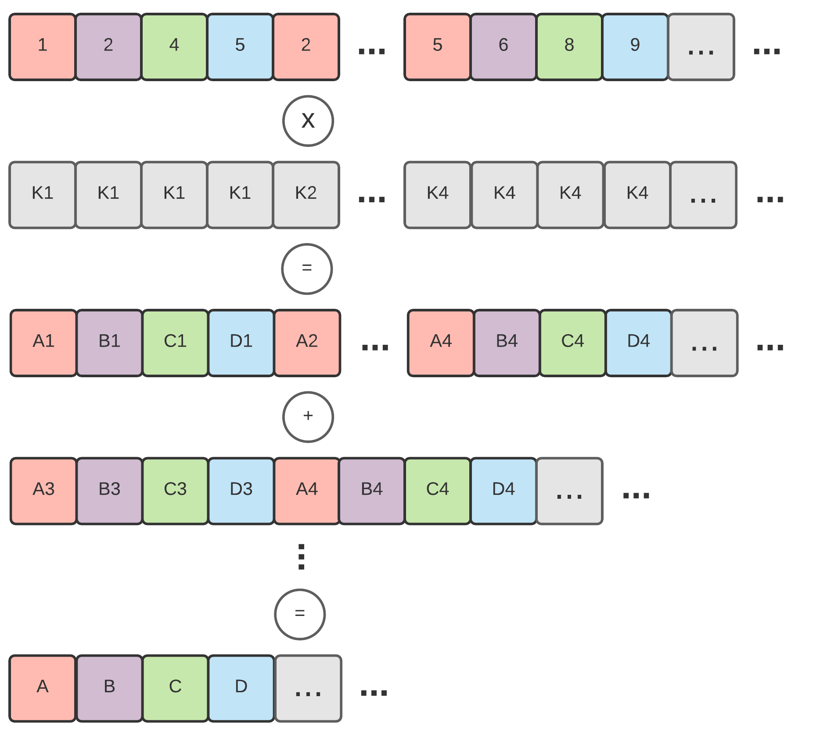
Homomorphic Convolution

Slide 12
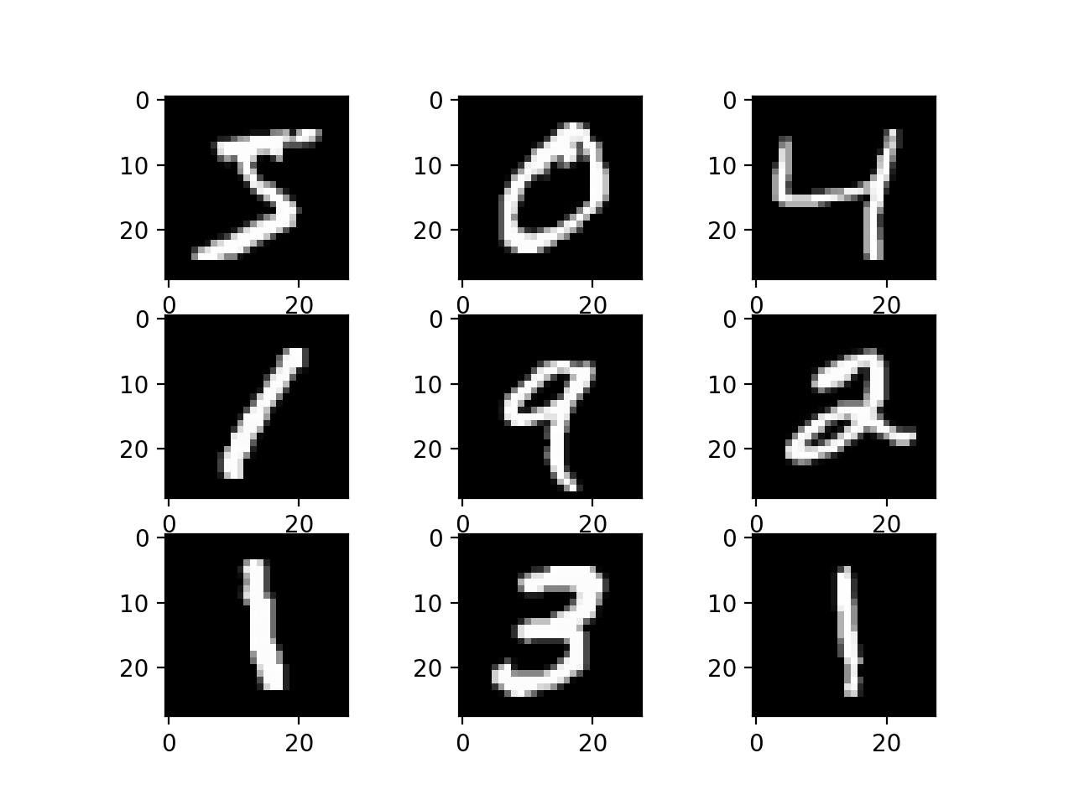
Implementation-Dataset
MNIST – 28x28 gray image
60,000 training dataset
10,000 testing dataset

Slide 13
Implementation - Model
Conv: Convolution with 4 kernels. Shape of the kernel is 7x7. Stride is 3.
Activation: Square activation function.
FC layer 1: Input size: 256. Output size: 64.
Activation: Square activation function.
FC layer 2: Input size: 64. Output size: 10.
Trained with Adam optimizer for 10 epochs and 32 batch size.
Test accuracy: 98%

Slide 14
Implementation- HE params
Poly modulus degree: 8192
Coeff modulus: [31, 26, 26, 26, 26, 26, 26, 31]
Scale: 26

Slide 15
Implementation - Tools
Tenseal – A Library for Encrypted Tensor Operations Using Homomorphic Encryption.
Django – A python library for backend.
Pytorch – Deep Learning Framework (for training model).
HTML/CSS/JS – For frontend.

Slide 16
Why Tenseal?
Best python wrapper for Microsoft Seal (C++).
Has built-in function to compute homomorphic vector-matrix multiplication (limited to one ciphertext).
Has built-in function to compute homomorphic convolution (limited to one ciphertext).
Can be easily integrated within popular deep learning frameworks (pytorch, tensorflow, etc.).

Slide 17
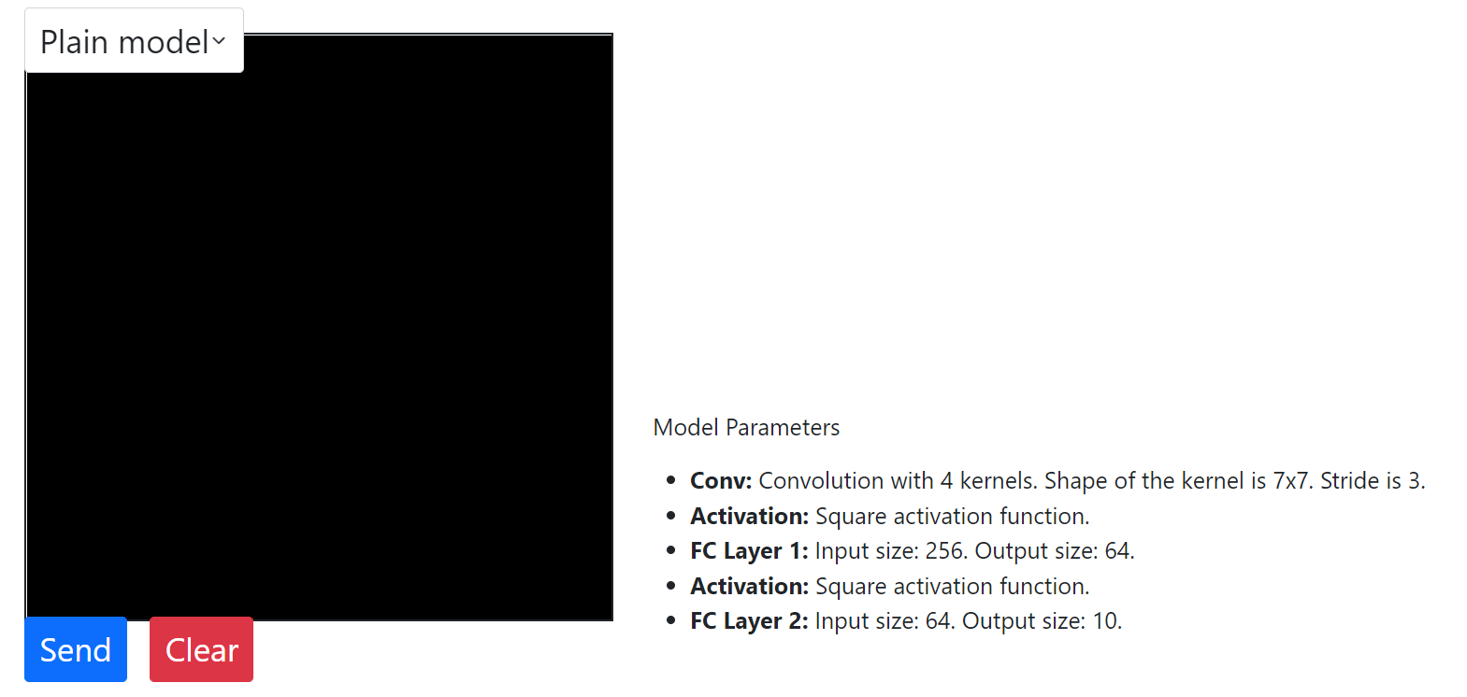
DEMO

Slide 18
There is no free lunch
HE model is about 1000 times slower than Plain model.
Security trades with speed.
More security means less efficiency.

Slide 19
THANK YOU FOR LISTENING

